Slide 1
“SHEPHERDING A CHILD’S HEART”
Hospers PCA Summer Seminars 2021
Tuesday, June 15 “Godward Orientation and Shaping Influences”
Tuesday, June 22 “Goals and Methods (Communication)”
Tuesday, July 6 “Biblical Methods of Discipline—the Rod and Appeal to Conscience”
(All seminars begin at 7:00 p.m.)

Slide 2
SHEPHERDING A CHILD’S HEART
Part One:
The Heart of the Matter
Shaping Influences
Godward Orientation
Authority Under God

Slide 3
INTRODUCTION
Christian parenting: God sovereignly entrusts precious children of inestimable worth, created in his own image, into the care of their parents.
Christian parents then covenant with God to raise the children he has entrusted to them in “the nurture and admonition of the Lord.” (Ephesians 6:4)
So we naturally turn to God’s Word and ask: What is our goal? and How do we get there?

Slide 4
INTRODUCTION
We must not ask the world for its counsel in this matter. The world is decisively biased in this regard, and not in a good way, not at all.
Our culture is so hopelessly messed up that it regularly destroys nearly a million of these precious children, created in God’s image, each year through abortion.
Sorry, but I do not trust any aspect of raising children in the Lord to a culture that says, “Hey, if you don’t want that child, if he or she is inconvenient, then throw her away.
You may have heard that Iceland has completely eradicated Down’s syndrome:
they just kill all Down’s syndrome children before they are born.
Problem solved.

Slide 5
INTRODUCTION
The obvious goal of parenting from this worldly perspective is the personal convenience and satisfaction/fulfillment of the parents.
God help us when the main concern in parenting is the convenience of the parents!
Then there are the willing accomplices who lend supposed “scientific” support for letting your children raise themselves.
Last year our four summer seminars centered on the roots of the sexual revolution, four major players from various academic fields who supposedly lent intellectual credibility to the new sexual (im)morality. But it was the summer of Covid-19, so few people came.

Slide 6
INTRODUCTION
All four of these pioneers in the fields of psychology, anthropology, sexology, and even theology,
Sigmund Freud,
Margaret Mead,
Alfred Kinsey, and
Karl Barth
worked diligently to overthrow the biblical ethic on sexual morality.

Slide 7
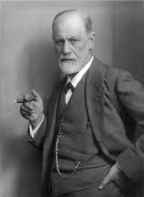
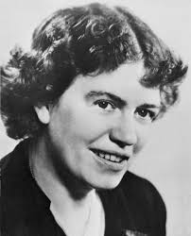
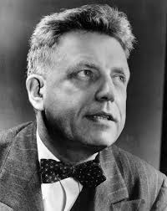
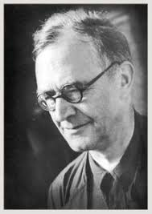
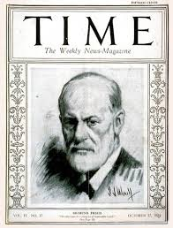
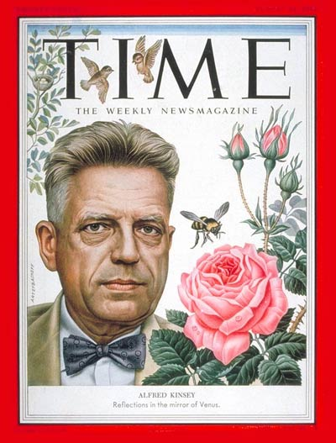
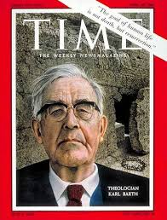

Slide 8
INTRODUCTION
And each was a sexual deviant in their own right, trying to justify their sexual aberrations:
Freud lusting after his sister-in-law,
Mead cheating on her husbands and living in a lifelong lesbian relationship on the side,
Kinsey producing his own pornography, seducing male grad students, and sexually molesting children, obviously criminal behavior, and
Karl Barth, we now know, taking his snappy young secretary into his own home where he subjected his old wife Nellie to his open adultery that lasted for decades.

Slide 9
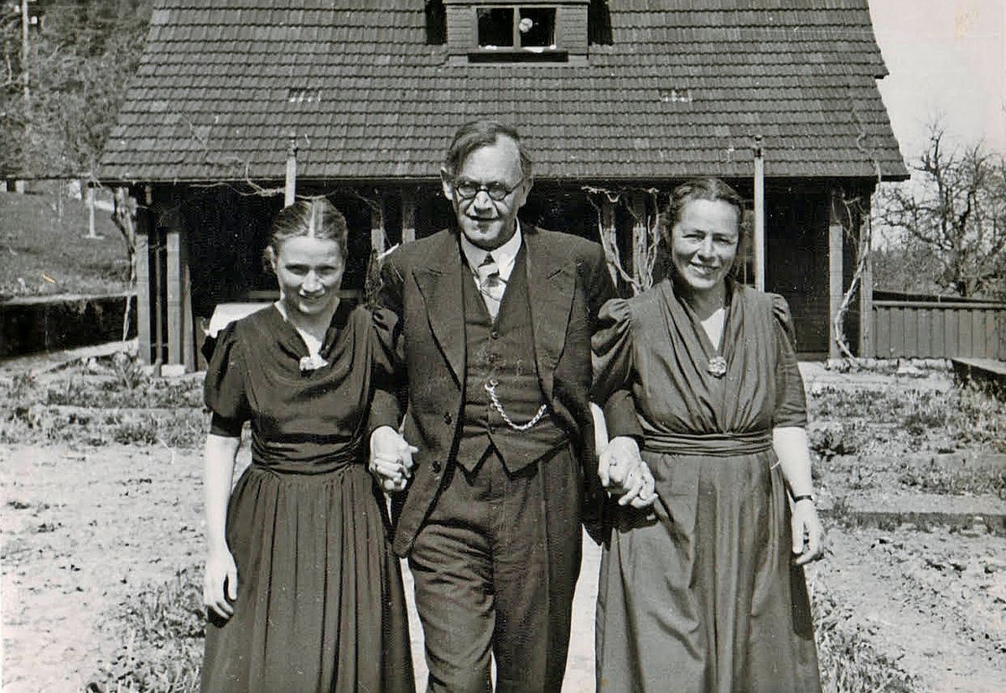

Slide 10
INTRODUCTION
But the anthropologist Margaret Mead is instructive for our purposes.

Slide 11
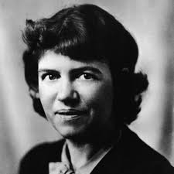
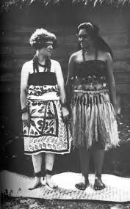
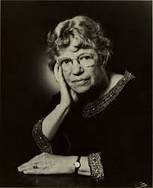
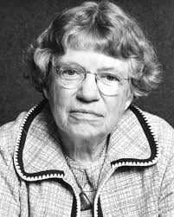

Slide 12
INTRODUCTION
Mead went off to the tropical island of Samoa and did about a half a year of part-time research in which she clearly fabricated her findings.

Slide 14
INTRODUCTION
A later researcher, Derek Freeman, spent years re-doing her research and found that almost all of her conclusions were the opposite of what was in fact, the documented, demonstrable truth.

Slide 15
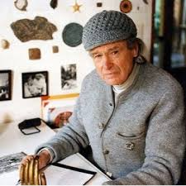
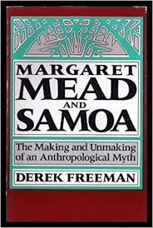

Slide 16
INTRODUCTION
And what did Margaret Mead supposedly find?
Free love among adolescents who were cavorting every night on the beach with new partners, no restraints, and living in a culture with no crime, no jealousy, totally open marriages, no disciplining of children, and little structure to the family.
Why, children didn’t even know who their own mothers were, but just responded to whatever woman offered care.
Sounds too good to be true? It was too good to be true. It was all made up.
When she was later confronted with the fact that there were virtually no unwed pregnancies in Samoa at that time, Mead lamely explained that such promiscuous behavior must have created a natural form of birth control. (For the first and only time in human history!)

Slide 17
INTRODUCTION
About that time there was a pediatrician named Dr. Benjamin Spock.

Slide 18
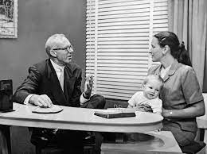

Slide 19
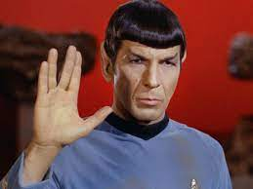

Slide 20
INTRODUCTION
Spock believed everything Margaret Mead had written.
He became famous himself as guru for child rearing in this hands-off, “let-children-do-as-they-please-for-they-will-always-get-it-right” method of child raising, and he became the leading light in this field for a whole generation.

Slide 21
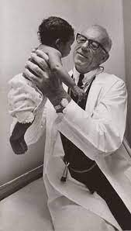

Slide 22
INTRODUCTION
My parents were of the generation trained by Dr. Spock, who based everything on Margaret Mead’s fictional findings.
Mead was so pleased with his work that she chose him as her personal pediatrician.
Full circle.
The deceiver is deceived.

Slide 23
INTRODUCTION
Add to that the tidal wave of humanistic psychology that swept over the twentieth century, led by Carl Rogers and Abraham Maslow among others.

Slide 25
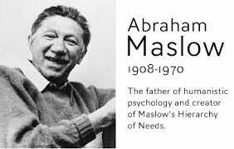
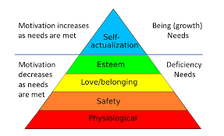

Slide 26
INTRODUCTION
The humanistic psychology of Rogers and Maslow taught that the self was always good and pure, that its desires were always right and noble.
The problems arose when people denied the desires of these pure selves, as the selves were developing (read, “saying ‘no’ to children) (echoes of Sigmund Freud).
Saying ‘no’ damaged the poor child’s self-esteem.
It was an example of “conditional positive regard.”

Slide 27
INTRODUCTION
This was supposed to be the root of virtually all mental illness: saying ‘no’ to your children. (“Blame your parents: it’s always their fault.”)
The “cure” was to supply “unconditional positive regard,” to affirm the damaged adult by saying ‘yes’ to everything they felt and desired. (“So you want to kill your neighbor. Good! Tell me how you feel about that.)
The “absolute acceptance,” this “unconditional positive regard,” would restore their self-esteem, and the truly good at heart, inner self would reemerge and express the wonder of its innate, perfect goodness once again.

Slide 28
INTRODUCTION
It is actually from the humanistic psychology of Carl Rogers that we get the idea of “unconditional love,” not from the Bible.
The bottom line, though, was that parents who placed any restrictions on their children were the real culprits, the evil creators of every kind of social ill. And we are reaping the fruits of this nonsense today.

Slide 29
INTRODUCTION
On the other hand, we find those who counsel moralism, the focus on behavior. “Just teach your kids to behave themselves. Find ways to modify their behavior, whatever it takes.”
As our children were entering their teenage years, I began to pay attention to the message of local youth programs aimed at adolescents: the “Red Ribbon” campaign or the “purity rings” given to girls as a pledge to remain chaste.

Slide 30
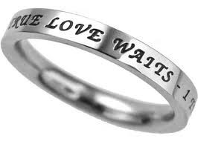

Slide 31
INTRODUCTION
And it seemed that morality was reduced to three goals for local teens:
1. Don’t drink underage
2. Don’t do drugs
3. Don’t have sex before marriage

Slide 32
INTRODUCTION
Are those worthy goals?
Sure. Of course.
But it seemed that these were the only goals.
“Hey, we’re all Christians here, so if your teenager can just steer clear of the big three, all will be well.”
And what is the common denominator with these “big three”?
Putting the best spin on it, we could say that avoiding these would spare your children some painful, lingering problems down the road.
But more cynically, violation of these just might embarrass the parents. In other words, they might create situations that are quite inconvenient to the parents: rehab, legal hassles, paying child support, and so forth.
So, again, it comes down to the convenience of the parents.

Slide 33
INTRODUCTION
I teach the students in my ethics class to watch out for “the fallacy of the middle way.”
People tend to assume that the middle way between two extremes is the right way. But this can be skewed and manipulated in a direction where the middle way is absolutely the wrong way.
ROB NO BANKS vs. ROB MANY BANKS
ROB SOME BANKS! (the middle way!)
Rob some banks” is the middle way. But if you think it is the right way, I would like to introduce you to my friend, a state trooper.
KILL NO JEWS vs. KILL ALL JEWS
KILL SOME JEWS? (the middle way!)

Slide 34
INTRODUCTION
And when it comes to raising children:
NO MORAL RESTRICTIONS vs. TOTAL MORAL RESTRICTIONS (MORALISM)
SOME MORAL RESTRICTIONS?
In other words, how much control of the children’s behavior should we seek? Minimal? Maximum? Moderate?

Slide 35
INTRODUCTION
And that’s why Tedd Tripp’s book Shepherding a Child’s Heart is so helpful.

Slide 36
INTRODUCTION
“Shepherding a Child’s Heart” takes the matter out of the realm of behavior, and locates the real heart of the issue where it belongs, the focus on the child’s “heart.”
This is the book I wish I had read before we had children. For me, it was too little, too late, even though by God’s grace we didn’t mess it up too much.
So in these three summer seminars I want to try to give the bird’s eye overview of Tripp’s proposal: that we focus not initially on behavior but on the heart.
The behavior is the overflow of the heart. And it is the heart we are aiming for.
This evening, Lord willing, we will try to cover the content of Tripp’s first four chapters.

Slide 37
I. IT IS THE HEART THAT MATTERS.
We must focus on the heart.
This study is wisely titled, “Shepherding a Child’s Heart,” because it is the child’s heart that we are most concerned with.
And as parents we function in the role of shepherd: protector, provider, and instructor keeping watch over the child’s heart.

Slide 38
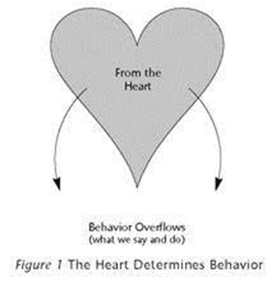
I. IT IS THE HEART THAT MATTERS.
The key text and the key premise upon which this is based is Proverbs 4:23:
“Keep your heart with all vigilance, for from it flow the springs of life.”

Slide 39
I. IT IS THE HEART THAT MATTERS.
Behavior, what we think and say and do, and character, who we are, flow from the heart.
In the Bible, the “heart” is not the seat of the emotions as we commonly imagine. That’s found a little lower in the anatomy, the bowels or the gut.

Slide 40
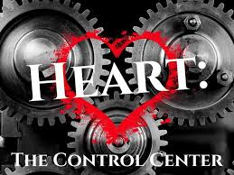
I. IT IS THE HEART THAT MATTERS.
Rather the heart is the control center in each person’s life, who they are at the core. And it is that control center, that heart, from which comes the outflow of our life.

Slide 41
I. IT IS THE HEART THAT MATTERS.
Jesus said in Mark 7:21-23:
“For from within, out of the heart of man, come evil thoughts, sexual immorality, theft, murder, adultery, coveting, wickedness, deceit, sensuality, envy, slander, pride, foolishness. All these evil things come from within, and they defile a person."
Jesus answers the age-old question for us:
Is a man a thief because he steals or does he steal because he is a thief?
Of course the second statement is the right one.
Actions flow from the heart. We “do” because we “are.”

Slide 42
I. IT IS THE HEART THAT MATTERS.
We tend to focus on behavior.
With parenting, it’s easiest to look to behavior, because behavior is what we observe and behavior is something that we can fairly easily control with the time-out chair or a system of punishments and rewards (bribes).
But behavior is only a symptom.
There was something amiss in the heart that produced that behavior, and it is that heart attitude that we must ferret out and address.
And that takes time, lots of time, lots of conversation and probing.
But it is the heart that we must be most concerned about, because the springs of life flow from the heart.

Slide 43
I. IT IS THE HEART THAT MATTERS.
Tedd Tripp makes a brilliant observation in the first chapter. Do you know what we usually call it when we simply change the behavior without changing the heart attitude?
Ordinarily we call that…
HYPOCRISY,
when we say or do one thing, but really think or feel something else.
And hypocrisy is everywhere condemned in Scripture.

Slide 44
I. IT IS THE HEART THAT MATTERS.
Listen to Tripp’s own words:
“A change in behavior that does not stem from a change in heart is not commendable; it is condemnable. Is it not the hypocrisy that Jesus condemned in the Pharisees? In Matthew 15, Jesus denounces the Pharisees who have honored him with their lips while their hearts were far from him. Jesus censures them as people who wash the outside of the cup while the inside is still unclean. Yet this is what we often do in childrearing. We demand changed behavior and never address the heart that drives the behavior.” (4)

Slide 45
I. IT IS THE HEART THAT MATTERS.
Now, of course, we must require proper behavior. God’s Word calls for obedience.
But this is where so many stop short and fail to address the heart attitude that caused the disobedient behavior in the first place.

Slide 46
I. IT IS THE HEART THAT MATTERS.
Tripp poses a common situation in families with multiple children: fighting over a toy.
What is the usual response to resolve this conflict? (Who had it first?)
This response seems to teach the child about justice, but it also teaches the child that the prize goes to the quickest.
And what we really have in this situation are two children with selfish hearts.
“Who had it first?” may solve the dispute in the short run, but it does nothing to address the underlying cause of two selfish hearts, two children both saying, “I care only for my own happiness. I care nothing for your happiness.”
And this is the case in all behavior. The heart attitude directs the behavior. So discipline must not simply treat the symptom, but the underlying cause as well.

Slide 47
I. IT IS THE HEART THAT MATTERS.
Focusing on the heart has great benefits.
1. Examining the heart attitude exposes the child’s sin.
2. It then leads to the cross of Christ and the need for a Savior.
3. And this reveals the glory of God’s grace who gave his Son that we might be forgiven and reconciled to him.
So this is the main goal God sets before us as we discharge our trust to raise the children he has loaned us.
We work backwards from the child’s behavior to the heart, exposing the sinful attitudes that produced the sinful behavior.
We examine ways the child is seeking a sinful response to satisfy a soul’s thirst which only Christ can satisfy.

Slide 48
I. IT IS THE HEART THAT MATTERS.
But it is this understanding, that the heart is the spring of life, which informs and controls our work.
We look to the all-sufficient Scriptures to examine the parenting task itself, the way a child develops, proper goals for us parents, and the best training methods.
This is not some new and improved technique to produce happy, well-adjusted, properly-behaved children.
This is a fresh way of seeing our task as parents to teach our children about themselves, the world they were born into, and especially to lead them to fulfill their responsibility before the God who made them.

Slide 49
II. THE CHILD’S DEVELOPMENT: UNDERSTANDING SHAPING INFLUENCES.
We must consider shaping influences.
What are “shaping influences”?
Tripp offers this definition: “those events and circumstances in a child’s developmental years that prove to be catalysts for making him or her the person they become.” (10)
We all know that a child’s environment is important.
For example, Dr. Ben Carson grew up in the slums but rose to become a famous surgeon. The story is remarkable because that kind of impoverished environment tends to inhibit achievement.
So we all sense the importance of these shaping influences.

Slide 50
II. THE CHILD’S DEVELOPMENT: UNDERSTANDING SHAPING INFLUENCES.
And God’s Word agrees.
For example, Deuteronomy 6:4-7:
“Hear, O Israel: The LORD our God, the LORD is one. You shall love the LORD your God with all your heart and with all your soul and with all your might. And these words that I command you today shall be on your heart. You shall teach them diligently to your children, and shall talk of them when you sit in your house, and when you walk by the way, and when you lie down, and when you rise.”
So there is the assumption that teaching important matters is to be a shaping influence as children are growing up.

Slide 51
II. THE CHILD’S DEVELOPMENT: UNDERSTANDING SHAPING INFLUENCES.
The New Testament agrees.
Ephesians 6:1-4: “Children, obey your parents in the Lord, for this is right. “Honor your father and mother” (this is the first commandment with a promise), ‘that it may go well with you and that you may live long in the land.’ Fathers, do not provoke your children to anger, but bring them up in the discipline and instruction of the Lord.”
Again there is the assumption that parents are to provide order and nurture as a helpful shaping influence upon their children.

Slide 52
II. THE CHILD’S DEVELOPMENT: UNDERSTANDING SHAPING INFLUENCES.
But it’s important to note that it is not only these shaping influences, but the child’s response to them that matters greatly, otherwise a child raised in a slum could never become a surgeon.
And here is the importance of the heart once again, for the child’s response will flow from their heart.
So what are these shaping influences?
Tedd Tripp lists six, and with a little thought they are quite obvious.

Slide 54
II. THE CHILD’S DEVELOPMENT: UNDERSTANDING SHAPING INFLUENCES.
1. One is the STRUCTURE OF FAMILY LIFE.
Is the family a traditional, nuclear family: Dad, Mom, and the kids? Or is it some other arrangement? And are grandparents readily available (and helpful) or not?
And what about the interaction between the parents? The birth order of the children affects each of the children, as well as their gender and relative ages.
Some time ago I spoke with a young man whose father was at best absent and often abusive. That young man was deeply impacted by this rejection by his father. He was longing for a strong male figure in his life. He was out of high school, but his emotional development and self-control had been arrested somewhere in the middle school ages.

Slide 55
II. THE CHILD’S DEVELOPMENT: UNDERSTANDING SHAPING INFLUENCES.
2. And likewise the FAMILY VALUES are of great importance.
What does the family/parents value highly? How do they treat the commodities of time and money? What virtues do they prize most highly?
How authentically do they live? Is there much hypocrisy? That is, how great is the discrepancy between their private and public lives?
Are there many secrets that must be kept, and what is the penalty for revealing a family secret?

Slide 56
II. THE CHILD’S DEVELOPMENT: UNDERSTANDING SHAPING INFLUENCES.
3. And FAMILY ROLES matter.
Within each family there are roles that each member plays. How well defined are these roles? How flexible are they? And how “traditional” are these roles?
Is the father involved with every aspect of life, or is he mostly absent and absorbed with career, work, or outside activities?
And is the mother employed outside the home? Who keeps the financial records and checkbook? Who does the household chores? Who takes care of the lawn, the car, the garage, the cooking, the laundry, the housecleaning?
And what is the role of the children? Are they the stars whom the parents serve? Are they servants whom the parents use?

Slide 57
II. THE CHILD’S DEVELOPMENT: UNDERSTANDING SHAPING INFLUENCES.
4. Another large shaping influence is FAMILY CONFLICT RESOLUTION.
Does the family know how to talk about, but more importantly resolve issues and problems?
Do family members genuinely listen to each other?
Children are largely equipped for conflict resolution by watching their parents disagree.
Some children observe their parents in conflict, but the resolution is done in private. So the children have no positive model for resolving conflict.

Slide 58
II. THE CHILD’S DEVELOPMENT: UNDERSTANDING SHAPING INFLUENCES.
5. The FAMILY RESPONSE TO FAILURE is another shaping influence.
Because children are children, their development will necessarily involve trial and error, with lots of error.
We sat with enough other parents during our children’s sporting events to know that some parents do not take failure very well.
Some families are constantly encouraging no matter the success or failure of the attempt.
Others demand perfection on the first try and might use shame or belittling as a tactic.
You can see how these responses would have a powerful shaping influence on developing children.

Slide 59
II. THE CHILD’S DEVELOPMENT: UNDERSTANDING SHAPING INFLUENCES.
6. And FAMILY HISTORY cannot help but be a shaping influence.
Has the family been marked by relative stability or great instability?
The failure of a marriage, constantly changing careers or residences, or the chronic sickness or disability of a family member can have a dramatic effect.
All of these factors will have their impact for better or for worse upon the family, and many of them are not entirely under the parents’ control.

Slide 60
II. THE CHILD’S DEVELOPMENT: UNDERSTANDING SHAPING INFLUENCES.
There are two great mistakes we can make when it comes to these shaping influences.
1. The first is to see these shaping influences deterministically, as though a child is entirely at the mercy of her environment, a complete victim of circumstances.
2. The other error is denial, to be completely unconcerned about these shaping influences and their impact on your children, as though they had no bearing.

Slide 61
II. THE CHILD’S DEVELOPMENT: UNDERSTANDING SHAPING INFLUENCES.
Tedd Tripp writes:
“You make a grave mistake if you conclude that childrearing is nothing more than providing the best possible shaping influences for your children. Many Christian parents adopt this ‘Christian determinism.’ They figure that if they can protect and shelter him well enough, if they can always be positive with him, if they can send him to Christian schools or if they can home school, if they can provide the best possible childhood experiences, then their child will turn out okay.” (15)
I have known some parents who have held this view, and have grieved with them when they discovered that it was not true.
What they forget or neglect is the heart, the Godward focus of the child.

Slide 62
II. THE CHILD’S DEVELOPMENT: UNDERSTANDING SHAPING INFLUENCES.
Tripp continues:
“Determinism makes parents conclude that good shaping influences will automatically produce good children. This often bears bitter fruit later in life. Parents who have an unruly and troublesome teenager or young adult conclude that the problem is the shaping influences they provided. They think if they had made a little better home, things would have turned out okay. They forget that the child is never determined solely by the shaping influences of life.” (16)
They forget what we found at the very beginning in Proverbs 4:23:
“Keep your heart with all vigilance, for from it flow the springs of life.”
The child’s heart determines how he responds to the shaping influences of his home and of his parent’s leadership.

Slide 63
II. THE CHILD’S DEVELOPMENT: UNDERSTANDING SHAPING INFLUENCES.
Of course the other mistake is also serious.
It is to deny that shaping influences have any impact, and so to neglect to provide a warm, healthy, safe, and structured home for children.
Many in the boomer generation were taught that self-fulfillment was the highest value. Sacrifice, duty, discipline, and nurturing children were often seen as obstacles to this self-fulfillment.
So the children of boomers were frequently neglected, even abandoned on this foolish quest for self-fulfillment.
It was the boomer generation that invented the “right” to abortion on demand, and the plain fact is that the overwhelming majority of abortions have been for “convenience.”

Slide 64
II. THE CHILD’S DEVELOPMENT: UNDERSTANDING SHAPING INFLUENCES.
And a previous generation, though experiencing the same number of marital difficulties, nevertheless tended to stay together
“for the sake of…
the children.”
My generation more often tended to split up
“for the sake of…
self-fulfillment.”

Slide 65
II. THE CHILD’S DEVELOPMENT: UNDERSTANDING SHAPING INFLUENCES.
One additional note before the break. Some of us may be thinking, “Okay, this is all well and good. But I never had any children.”
Or “My children are all grown and gone, so it’s a little late for me.”
But what we must remember is that God is our Father, and these dynamics, the focus on the heart, for example, are applicable to us as well.
We can easily fake good behavior.
But it’s the stuff in private that really exposes our hearts.
And that’s where we must fight our battle as well.

Slide 66
“SHEPHERDING A CHILD’S HEART”
Hospers PCA Summer Seminars 2021
Tuesday, June 15 “Godward Orientation and Shaping Influences”
Tuesday, June 22 “Goals and Methods (Communication)”
Tuesday, July 6 “Biblical Methods of Discipline—the Rod and Appeal to Conscience”
(All seminars begin at 7:00 p.m.)

Slide 67
A REALITY CHECK…
What we are simply doing is applying biblical truths to God’s call for parents to raise the children he has entrusted to them.
Many of these biblical truths have been neglected.
Tripp did not invent these truths, of course, but merely applied them once again.
Professor John Frame describes theology as “the application of the Word of God by persons to every aspect of human life.”
So the principles in “Shepherding a Child’s Heart” are the application of the Word of God to the work of Christian parenting.

Slide 68
III. YOUR CHILD’S DEVELOPMENT: GODWARD FOCUS
Here is the key that ties it all together.
It is your child’s Godward focus that determines his or her response to shaping influences.
If the child trusts and bows before God, then the positive situations will be cause for gratitude, and the difficult, painful times will be occasions for deepening trust and developing perseverance.
But if the child does not trust and submit to God, then the positive will be presumed, expected, demanded, and the difficult times will spark anger or rebellion or depression.

Slide 69
III. YOUR CHILD’S DEVELOPMENT: GODWARD FOCUS
Proverbs 9:7-10 demonstrates these differing responses to the same shaping influences depending on the person’s heart:
“Whoever corrects a scoffer gets himself abuse, and he who reproves a wicked man incurs injury. Do not reprove a scoffer, or he will hate you; reprove a wise man, and he will love you. Give instruction to a wise man, and he will be still wiser; teach a righteous man, and he will increase in learning. The fear of the Lord is the beginning of wisdom, and the knowledge of the Holy One is insight.”
(If you correct someone and they get angry and say, “Who do you think you are?” then they have just told you who they are.)

Slide 70
III. YOUR CHILD’S DEVELOPMENT: GODWARD FOCUS
Every human being is essentially religious in nature.
That’s because God made us for himself, and so we cannot help but be worshipers.
Another way of saying this is that people are covenantal beings. We were brought into this world to be in a covenant relationship with God.
In Romans 1, Paul assumes that people are born knowing this to be true, but because we don’t really want it to be true, because we want to be autonomous beings, we suppress this truth:
“For the wrath of God is revealed from heaven against all ungodliness and unrighteousness of men, who by their unrighteousness suppress the truth. For what can be known about God is plain to them, because God has shown it to them.” (Romans 1:18-19)

Slide 71
III. YOUR CHILD’S DEVELOPMENT: GODWARD FOCUS
What this means is that every person must choose between two ways.
Either we will be worshipers of God or we will worship something else.
By this I mean that either we will love and value God above all and consistently look to him for our needs and for our happiness, or we will value something else more highly and seek our satisfaction and fulfillment from it.
The point is that we are natural born worshipers.
We know we do not have what we need in ourselves, so we will always seek it from another: we will always worship something.

Slide 72
III. YOUR CHILD’S DEVELOPMENT: GODWARD FOCUS
And it is important, perhaps supremely important to understand that every child born in the ordinary way is born already bent toward sin and self. Every ordinary child comes into the world with a sinful, not a Godward orientation.
King David understood this and declared this in Psalm 58:3: “The wicked are estranged from the womb; they go astray from birth, speaking lies.”
Perhaps we are more familiar with his own confession in Psalm 51:5: “Behold, I was brought forth in iniquity, and in sin did my mother conceive me.”
So sin begins at conception (which explains the need for the virgin birth of our Lord Jesus). And here again we find the answer to that age old question: “Is a man a sinner because he sins, or does he sin because he is a sinner?” Of course, the latter is true.

Slide 73
III. YOUR CHILD’S DEVELOPMENT: GODWARD FOCUS
So what we must come to grips with is that the heart is not neutral.
Either the child will look to God or to idols.
And by the way, we should define “idol.” Tripp defines idols this way:
“These idols are not small wooden or stone statuary. They are the subtle idols of the heart. The Bible describes such idols using terminology such as fear of man, evil desires, lusts, and pride. The idols include conformity to the world, embracing earthly mindsets, and ‘setting the affections on things below.’ What we have in view are any manner of motives, desires, wants, goals, hopes, and expectations that rule the heart of the child. Remember these things do not have to be articulated to be present.” (21)

Slide 74
III. YOUR CHILD’S DEVELOPMENT: GODWARD FOCUS
The point, though, is that children do respond to the circumstances of life, to the shaping influences according to their orientation, either out of true faith in God or idolatrous unbelief.
And so the most basic choice which is often unconscious, below the surface is the choice of whom one will worship.
This is what motivates the heart, which in turn directs all behavior.

Slide 75
III. YOUR CHILD’S DEVELOPMENT: GODWARD FOCUS
Here we have the defining issue, and this is really what is missing in much of the child-training counsel in our day.
“The child is neutral,” we are told, “a blank canvas upon which parents paint, wet clay which parents mold and shape by their parenting skills.”
But there is much more involved.
All children are natural born sinners who will either trust and submit to God and respond in faith or will look to idols to bring happiness, and so respond from a self-centered perspective.

Slide 76
III. YOUR CHILD’S DEVELOPMENT: GODWARD FOCUS
We must, as Dr. Tripp says, engage our children on the smallest battlefield in the world: the child’s heart.
So, yes, we must provide positive, godly shaping influences.
But that is not adequate.
In years past, raising children was compared to programming a computer, and the principle of “garbage in, garbage out” was invoked.
If you program bad data into a computer, the computer cannot help but respond with bad results, “garbage in, garbage out.”

Slide 77
III. YOUR CHILD’S DEVELOPMENT: GODWARD FOCUS
Of course what this was doing was de-humanizing children, comparing them to non-thinking, non-choosing computers.
But children are not like that. Shaping influences alone are not adequate.
Some children can have a garbage upbringing, but rise to shine like stars.
Other children can have the best upbringing, but utterly reject it and plunge into sin.

Slide 78
III. YOUR CHILD’S DEVELOPMENT: GODWARD FOCUS
So, along with shaping influences, do battle for the heart.
“Your child is not just a product of those shaping influences. He interacts with those things…according to the nature of the covenantal choices he is making. Either he responds to the goodness and mercy of God in faith, or he responds in unbelief. Either he grows to love and trust the living God, or he turns more and more to various forms of idolatry.” (22-3)
We may not simply conclude that that behavior is mere immaturity.
Dr. Tripp writes: “Selfishness is not outgrown. Rebellion against authority is not outgrown. These things are not outgrown because they are not reflective of immaturity, but rather of the idolatry of your child’s heart.” (23)

Slide 79
III. YOUR CHILD’S DEVELOPMENT: GODWARD FOCUS
He concludes this portion by giving two biblical examples of this important truth.
Joseph’s shaping influences were not ideal. Favored and spoiled by his father, he was hated and sold into slavery by his own brothers. There in slavery, he was falsely accused and treated with great injustice.
Yet he remained faithful to God to the end and even forgave and cared for his awful brothers.
The other example was that of the Hebrew slave girl to Naaman’s wife recorded in 2 Kings 5.
She had been captured as a child, torn from her family, and reduced to slavery. Yet she also remained faithful and witnessed to the saving power of God.

Slide 80
III. YOUR CHILD’S DEVELOPMENT: GODWARD FOCUS
Something went right with these two which cannot be explained by mere shaping influences.
Here we find a heart that is oriented toward God in covenant faithfulness.

Slide 81
IV. YOU ARE IN CHARGE AS GOD’S AGENTS
The next big idea is what Paul Tripp discusses in his fourth chapter, and it is huge.
Simply put, parents are called to shepherd their children on God’s behalf.
God is the true Father and Shepherd, but he has ordained to shepherd children through their parents.
Parents are acting as God’s agents.

Slide 82
IV. YOU ARE IN CHARGE AS GOD’S AGENTS
When God made the world, he placed it under the authority of the first man and woman, Adam and Eve.
God was the great King, but Adam and Eve were his governors. They were to rule over God’s creation on his behalf.
But something went terribly, terribly wrong.
The governor somehow thought he was king. He rebelled against the true King, and now the rest of creation was placed in a terrible position: to obey the King in spite of the governor, and all became terribly messed up. But that is another story.
The point is that God is still employing this plan. He is ruling over his creation through his human agents.
And he ordains to oversee the children he created through the agency of their parents.

Slide 83
IV. YOU ARE IN CHARGE AS GOD’S AGENTS
Now we should note a couple of things here.
First, an agent must understand that he is only representing the king, not him or herself.
So they must be faithful to the king and always point their subjects to the king.
And so the subjects must respond to the agent as to the king, as unto God, and they will ultimately answer to God for how they respond to his agents, their parents.
But almost all of this is lost on people today. We tend, instead, to take it all personally, and this is a gigantic mistake.

Slide 84
IV. YOU ARE IN CHARGE AS GOD’S AGENTS
Tripp says it very well.
“Our culture does not like authority. It is not just that we don’t like to be under authority, we don’t like being authorities. One of the places where this is most clearly seen is in our discomfort with authority in the home.” (27)

Slide 85
IV. YOU ARE IN CHARGE AS GOD’S AGENTS
We must understand these issues clearly or we will always either be hesitant and tentative, or perhaps authoritarian and heavy-handed.
“If you are unsure about the nature and extent of your authority, your children will suffer greatly. They will never know what to expect from you because the ground rules will be constantly changing. They will never learn the absolutes and principles of God’s Word that alone teach wisdom.” (27)

Slide 86
IV. YOU ARE IN CHARGE AS GOD’S AGENTS
Our culture has no real concept of biblical authority.
We think that authority either arises from overwhelming force or from “the consent of the governed.” So our response is either rebellion or dejected servility.
People today cannot conceive of intelligent, capable people willingly placing themselves under the authority of another.
Tripp points out that “When we allow our children to become independent decision makers we give them a false idea of liberty and a mistaken notion about freedom. Freedom is not found in autonomy, it is found in obedience.” (27)
And he references Psalm 119:44-45 which states: “I will keep your law continually, forever and ever, and I shall walk in a wide place, for I have sought your precepts.”

Slide 87
IV. YOU ARE IN CHARGE AS GOD’S AGENTS
What all this means is that parents have authority only because God calls parents to be that authority in their children’s lives.
Fathers and mothers are not exercising rule over their own jurisdictions, but over God’s jurisdiction.
Children belong to God, and he entrusts them to their parents for a time.
So parents are managing, overseeing God’s precious property, not their own.
Parenting is a duty that God charges to fathers and mothers.

Slide 88
IV. YOU ARE IN CHARGE AS GOD’S AGENTS
And all of parenting must be accomplished from this perspective. The task must be undertaken and fulfilled because God calls us to it.
For example, in Deuteronomy 6, God says that parents are to learn God’s commandments and then teach them to their children. Each generation is to respond to God in faithfulness, led by the agency of the parents.
Paul agrees in Ephesians 6:4: Fathers are to raise their children in the nurture and admonition OF THE LORD. God could do that himself, of course, but he has ordained fathers to do so. Tripp says it well:
“Understanding this simple principle enables you to think clearly about your task. If you are God’s agent in this task of providing essential training and instruction in the Lord, then you, too, are a person under authority. You and your child are in the same boat. You are both under God’s authority. You have differing roles, but the same Master.” (29)

Slide 89
IV. YOU ARE IN CHARGE AS GOD’S AGENTS
All of this gets confused by parental anger.
When a parent becomes angry at a child’s disobedience, what signal does it send?
It tells the child that this was really a contest of wills between parent and child.
It tells the child that the parent has forgotten he’s only a governor and instead thinks he is the king. But only God is the King.

Slide 90
IV. YOU ARE IN CHARGE AS GOD’S AGENTS
“Unholy anger—anger over the fact that you are not getting what you want from your child—will muddy the waters of discipline. Anger that your child is not doing what you want frames discipline as a problem between parent and child, not as a problem between the child and God. It is God who is not being obeyed when you are disobeyed. It is God who is not being honored when you are not honored. The issue is not an interpersonal contest, it is rather your insistence that your child obey God, because obeying God is right and good.” (29) We’ll say more about this in a bit.

Slide 91
IV. YOU ARE IN CHARGE AS GOD’S AGENTS
Parenting is a call to obedience.
Parents must first obey God themselves, and then they must require obedience to God from their children.
1. This understanding provides the confidence to act.
You don’t have to wonder if it’s okay for you to be in charge. You don’t have to stumble over the question of “who do you think you are” to tell your children what to do.
You are called and commissioned to act by God and on his behalf.

Slide 92
IV. YOU ARE IN CHARGE AS GOD’S AGENTS
2. But this understanding is also a mandate to act.
Many states have “mandatory reporter laws.” If a school administrator or medical worker even suspects child abuse, for example, they don’t have to decide whether or not to report it: the law requires, even demands it. Mandatory reporters are under obligation to act.
And parents are under obligation by God to correct and discipline their children.

Slide 93
IV. YOU ARE IN CHARGE AS GOD’S AGENTS
Many parents today do not understand this calling and commission and so do not fulfill it.
They see themselves in the role of advisor, helping children to think through choices but leaving the final decision to the child.
Or they think of parenting as mere providing: “The child must have food, clothes, a bed, and some good quality time.”

Slide 94
IV. YOU ARE IN CHARGE AS GOD’S AGENTS
Tripp notes:
“In sharp contrast to such a weak view, God has called you to a more profound task than being only a care-provider. You shepherd your child in God’s behalf. The task God has given you is not one that can be conveniently scheduled. It is a pervasive task. Training and shepherding are going on whenever you are with your children. Whether waking, walking, talking or resting, you must be involved in helping your child to understand life, himself, and his needs from a biblical perspective.” (32)

Slide 95
IV. YOU ARE IN CHARGE AS GOD’S AGENTS
Shepherding means that parents will have clearly defined objectives for their children.
If you ask most parents what training objectives they have for their children, they will not be able to answer.
This is because they are thinking in terms of “providing” rather than “shepherding.”
“Providing” focuses on making the essentials available and letting the child develop on their own.
“Shepherding” is much more, giving direction and working toward goals.
Providers play a secondary role; directors are in charge.

Slide 96
IV. YOU ARE IN CHARGE AS GOD’S AGENTS
Understanding we are merely God’s agents interjects humility into our work of parenting.
A military chaplain I knew told me of participating in a meeting with a U.S. ambassador to another nation. As the ambassador spoke, he constantly said, “The position of the United States government is this.” He wasn’t there to air his own opinion, but was merely an agent representing his president.
And as parents we need to adopt the same understanding.
We are serving our heavenly Father in raising children who ultimately belong to and will answer to him.
And we are under the same authority.

Slide 97
IV. YOU ARE IN CHARGE AS GOD’S AGENTS
What this implies is that there is no place for anger in raising our children.
Tripp writes: “I have spoken to countless parents who genuinely thought their unholy anger had a legitimate place in correction and discipline. They reasoned that they could bring their children to a sober fear of disobeying if they showed anger. So discipline became the time when Mom or Dad manipulated their children through raw displays of anger. What the child learns is the fear of man, not the fear of God.” (34)

Slide 98
IV. YOU ARE IN CHARGE AS GOD’S AGENTS
He points to James 1:19-20:
“Know this, my beloved brothers: let every person be quick to hear, slow to speak, slow to anger; for the anger of man does not produce the righteousness that God requires.”
The righteous life God requires is never the result of uncontrolled anger.
So, Tripp notes, “Any change in behavior that is produced by anger is not going to move your children toward God. It moves them away from God. It moves them in the direction of the idolatry of fearing man.” (34)

Slide 99
IV. YOU ARE IN CHARGE AS GOD’S AGENTS
And that means that discipline is a matter of correction, not punishment.
If discipline is about satisfying a parent who has been offended, then it will result in venting anger or perhaps getting even.
If it is a matter of God as the one who is offended, then discipline will be about restoration.
It will always be corrective rather than punitive.

Slide 100
IV. YOU ARE IN CHARGE AS GOD’S AGENTS
And so discipline will be an expression of love.
Tripp mention’s overhearing a conversation at a pastor’s conference.
One pastor explained that he was the disciplinarian in the home, while the wife was more loving.
Another suggested that they needed to strike a balance between love and discipline.
But this surely misses the point.
Discipline IS an expression of love.
Tripp reminds us of Proverbs 3:12: “for the LORD reproves him whom he loves, as a father the son in whom he delights.”
And Proverbs 13:24: “Whoever spares the rod hates his son, but he who loves him is diligent to discipline him.”

Slide 101
“SHEPHERDING A CHILD’S HEART”
Hospers PCA Summer Seminars 2021
Tuesday, June 15 “Godward Orientation and Shaping Influences”
Tuesday, June 22 “Goals and Methods (Communication)”
Tuesday, July 6 “Biblical Methods of Discipline—the Rod and Appeal to Conscience”
(All seminars begin at 7:00 p.m.)

